Slide 1
Notes:
<number>

Slide 2

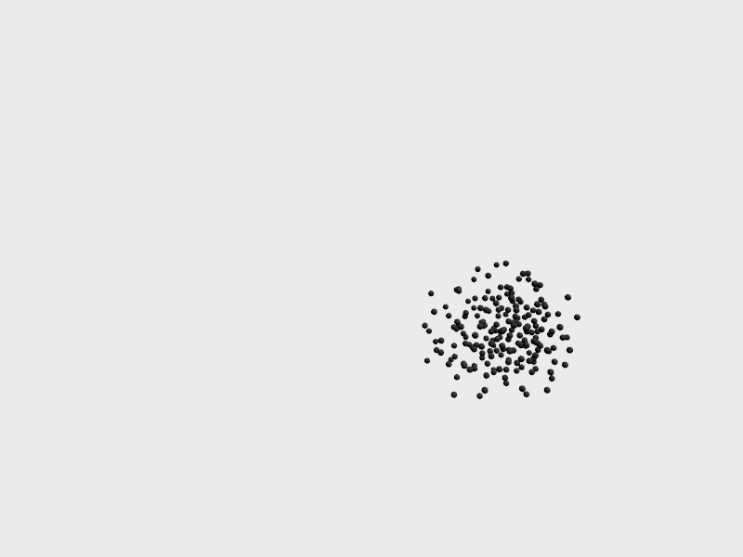
Background
A common form of swarm control leverages virtual forces generated through proximity to neighbors [1]
Often combined with orientation matching. Such agents are referred to as Boids (shown below)
Easy to implement with global sensing (i.e. Vicon) but this removes the swarm’s portability
Emergent Behavior from Local Sensing
<number>
1. Brambilla, M. et al, Swarm robotics: A literature review, 2014
Notes:
<number>

Slide 3
Project Goal
Implement virtual force control using onboard sensing and computing
Explore emergent behavior resulting from inherent sensor limitations
Constraints:
No agent-to-agent communication that would reduce scalability
No specialized sensors
Portable anywhere the agents can operate
Emergent Behavior from Local Sensing
<number>
Notes:
<number>

Slide 4
Simulations
Used MATLAB to create simulation environments
Allowed me to quickly iterate through possible onboard sensing configurations as I became familiar with blimp design and control
Early simulations used single integrator dynamics
Agents ‘sensed’ closest neighbors and simply moved to their average location
Emergent Behavior from Local Sensing
<number>
Notes:
<number>

Slide 5
Simulations
A few obvious problems
Single integrator dynamics are not useful in most cases
Agents cannot always sense their closest neighbors, only the closest neighbors within the sensor’s ‘line of sight’
Emergent Behavior from Local Sensing
<number>
Notes:
<number>

Slide 6
Simulations - Dynamics
Eventually moved to double integrator dynamics with orientation included as a state
Dampening values approximated with early blimp designs
Emergent Behavior from Local Sensing
<number>
Notes:
<number>

Slide 7
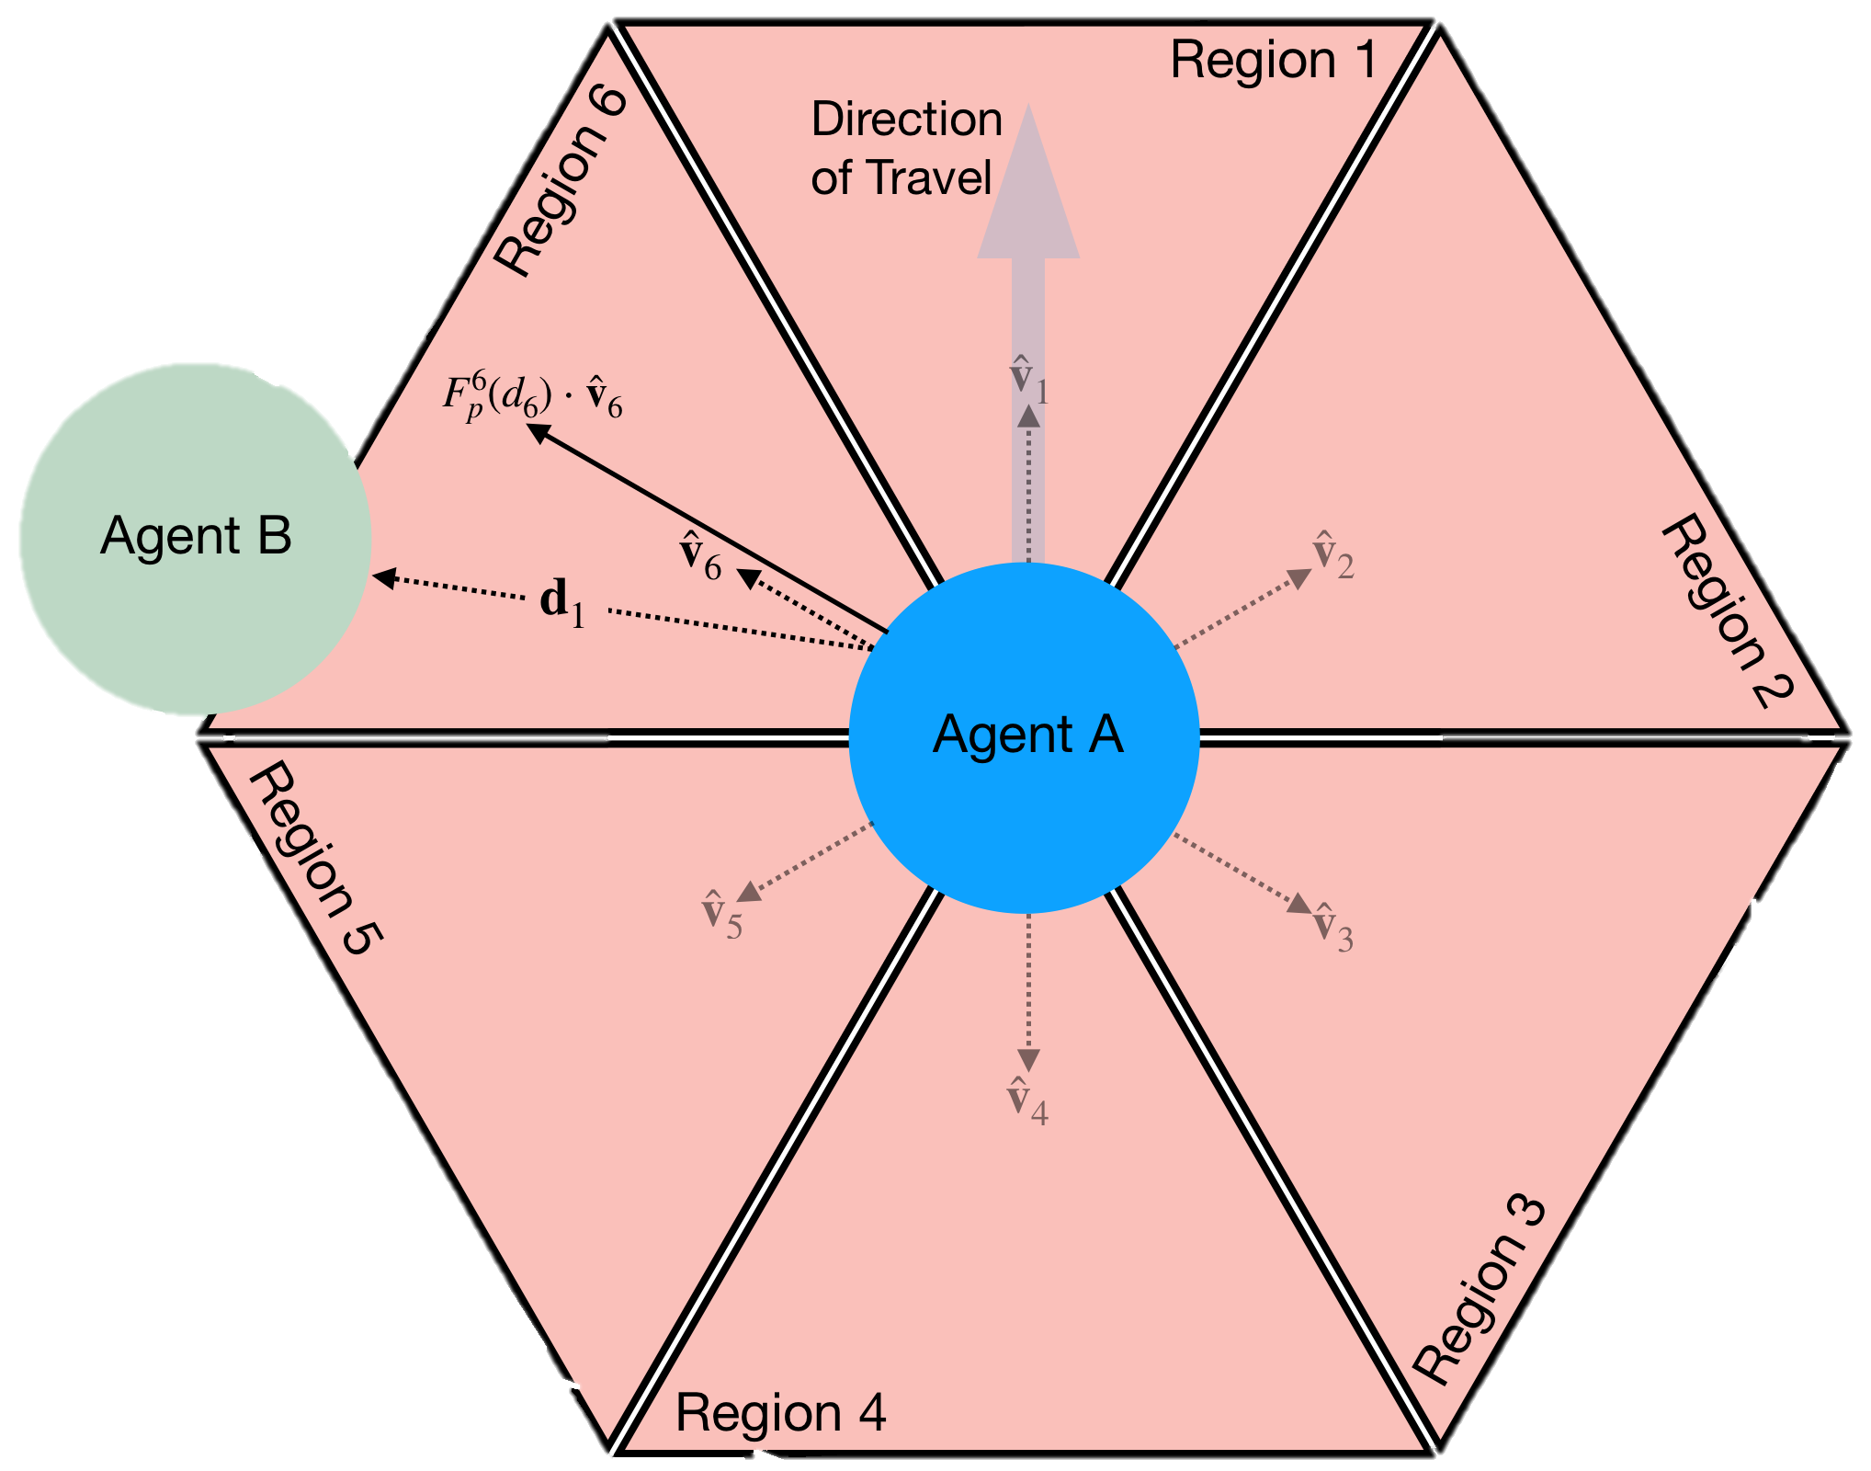
Simulations - Sensing
Senses the closest neighbors
Up to one neighbor sensed per region
If a zone had no neighbors within its sensing range, treat as empty
All agents share an orientation. Allows coordinated movement
Emergent Behavior from Local Sensing
<number>
Notes:
<number>

Slide 8
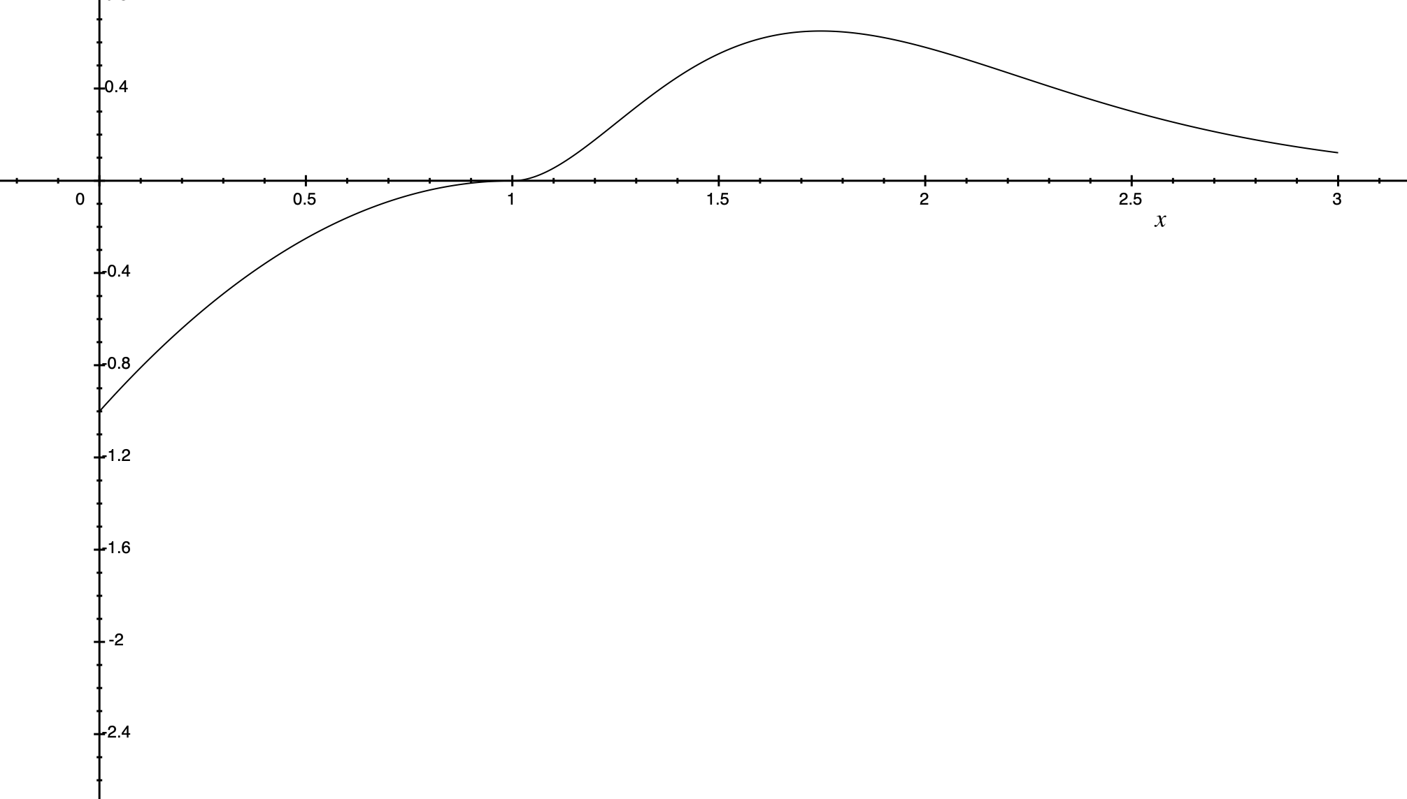
Simulations – Parameter Adjustment
Parameters where adjusted to reveal hidden emergent behavior
Only parameters that could be adjusted globally where explored including;
Virtual force characteristics
Force profile
Max force magnitudes
Equilibrium distance
Max sensing distance
Region based weighting
Global forces
Emergent Behavior from Local Sensing
<number>
Notes:
<number>

Slide 9
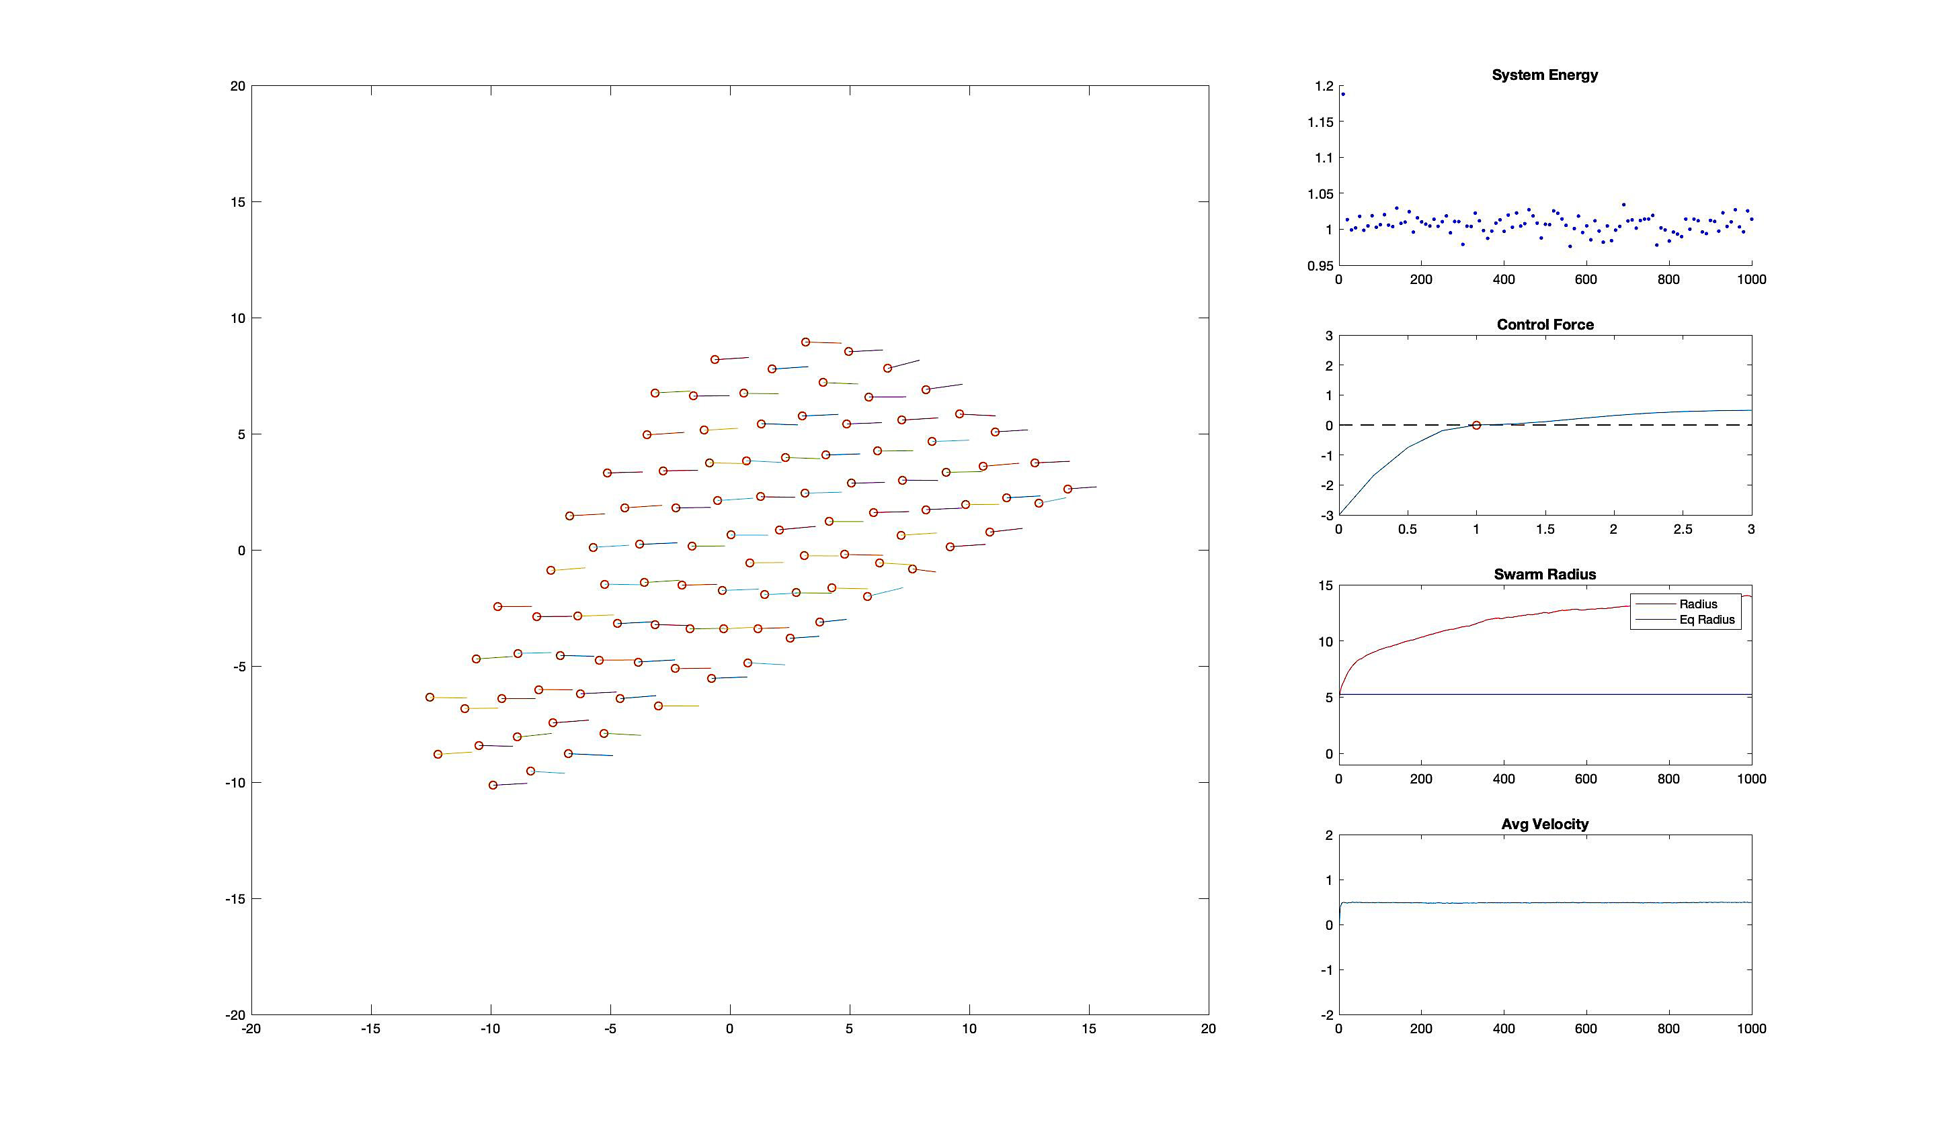
Simulations – Emergent Behavior
Basic emergent behavior such as clustering observed
Tuning the virtual force curve parameters allowed ordered ‘crystalline’ formations
Regional equilibrium distances and a global force resulted in an ‘Arrow Formation’
Emergent Behavior from Local Sensing
<number>
Notes:
<number>

Slide 10
Agent Design - Goal
Build a LTA agent that would reflect the simulations using on-board computing and sensing alone
Be able to control the swarm’s position and properties using a single centralized controller, regardless of scaling
Emergent Behavior from Local Sensing
<number>
Notes:
<number>

Slide 11
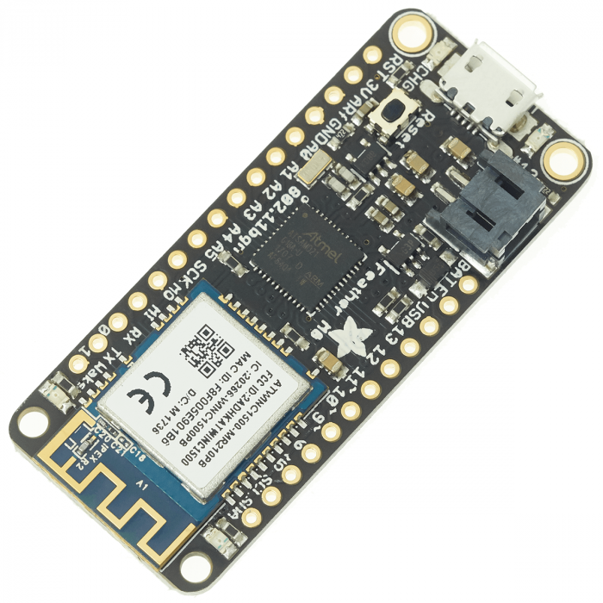
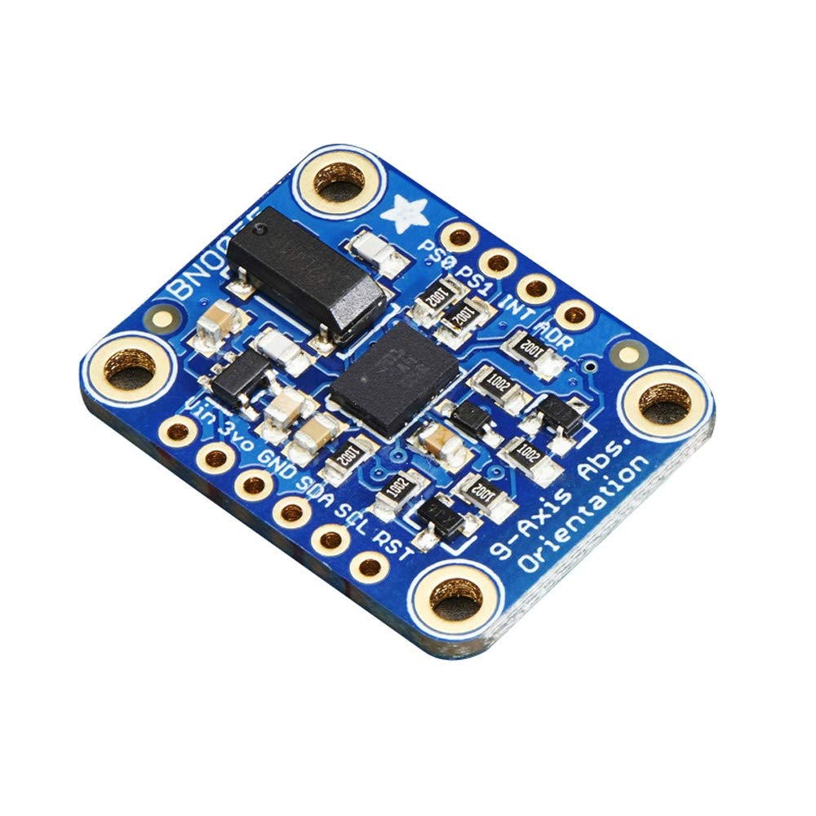
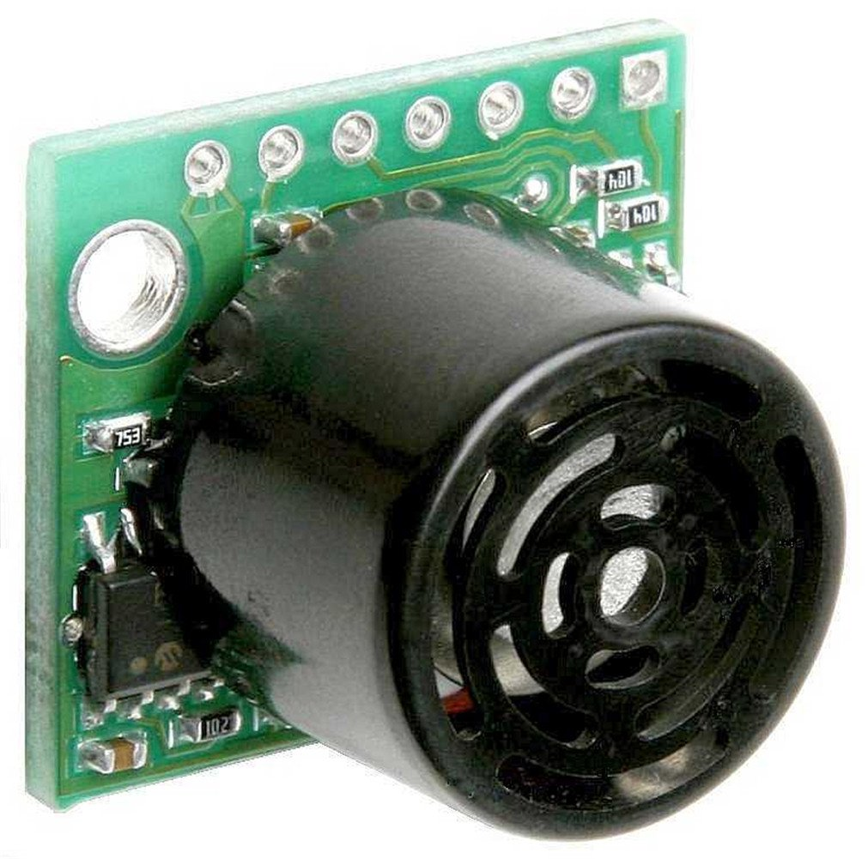
Agent Design
Controller - Adafruit Feather M0
Communication – Integrated WIFI, UDP broadcast client
Localization - MaxBotix ping sensors (6-7 per agent)
Orientation – Adafruit BNO055 IMU sensor
Emergent Behavior from Local Sensing
<number>
Notes:
<number>

Slide 12
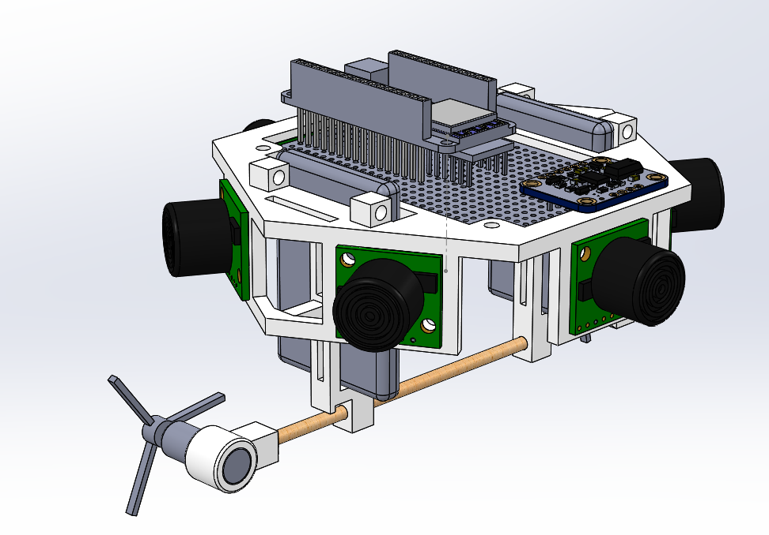
Agent Design – Ver 1
Two envelopes
Differential drive system
Drag sting altitude control
Emergent Behavior from Local Sensing
<number>
Notes:
<number>

Slide 13
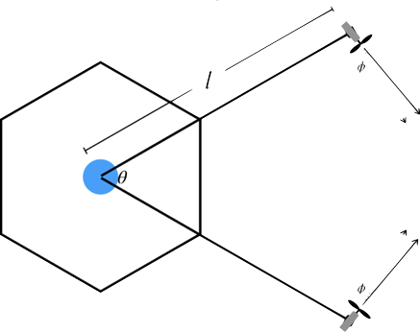
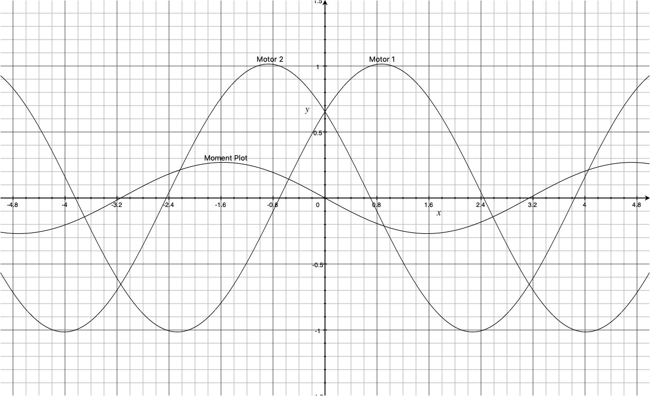
Agent Design
Offset Holonomic Drive
Unlike traditional holonomic drives, this drive maintains a forward direction
Simple to control. By just controlling for heading, a correcting moment is applied as a by product
Emergent Behavior from Local Sensing
<number>
Notes:
<number>

Slide 14
Agent Design – Controller
Setting up…
Configure Motor Driver
Connect to BlimpNet
Calibrate IMU
Begin Firing Pings
Drive Motors
Servo Height
Calculate Motor Inputs
Parse Global Input
Control Loop
Ping Interrupt Service Routine
Sum Force Vectors and Input
Calculate Force Vectors
Read Ping Sensors
Clean Data
Fire Pings
Emergent Behavior from Local Sensing
<number>
Notes:
<number>

Slide 15
Testing
Preliminary tests have been run to assess the qualitative nature of the blimps
Parameters that need tuning
Virtual force curve
Ping frequency
Ping data filtering
Ping positioning
Altitude PID parameters
Once tuned, Vicon will be used to capture the quantitative response to motor inputs
This data will be used to tune the simulation parameters until the results match
Emergent Behavior from Local Sensing
<number>
Notes:
<number>

Slide 16
Future Work
Move the simulation from MATLAB to a faster platform such as Scrimmage
Develop a way for the agents to differentiate between a fellow agent and other objects. This would allow the agents to work in tight spaces without ‘sticking’ to the walls
Expand sensing to a sphere around the agent
Create a global State Space that includes things such as
Average swarm location
Swarm radius/density
Swarm fanning (column or row formations)
Implement deployable sensors that would allow a centralized controller to use the global State Space and an advanced control to accomplish a task
Emergent Behavior from Local Sensing
<number>
Notes:
<number>

Slide 17
Notes:
<number>

